Slide 1


MICROSOFT ACCESS
To highlight the cardinals of the best database management system "MC ACCESS".

Slide 2

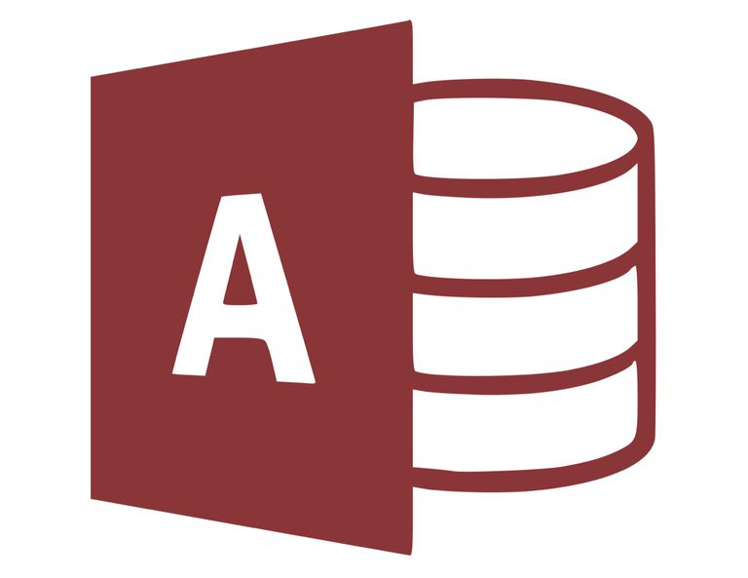

INTRODUCTION
ACCESS is a popular DBMS/RDMS (Relational Database Management system) which is included in the MS-suite.
It is a type of database software that is used to store information for reporting, referencing, and analysis.
With Microsoft Access, you can analyze large amounts of data faster and more efficiently as compared to Excel or other types of spread sheet

Slide 3



SO, WHICH VERSION OF MICROSOFT ACCESS IS CURRENTLY THE BEST ONE?
SO, WHICH VERSION OF MICROSOFT ACCESS IS CURRENTLY THE BEST ONE?

Slide 4
COMPARISON BETWEEN OLDER AND NEWER VERSIONS
PRE 2019 ACCESS FEATURES
2019 ACCESS FEATURES
Local table from a linked table.
Autocorrect options.
Backup a database or project.
Error checking in forms and reports.
Reporting with conditional formatting.
Themes.
Live preview.
Visualize data with new charts (column charts, line charts, bar charts, pie charts etc).
Large number (bigint) support.
Support for dBASE is back.
Property sheet storing.
Ney label name property for controls.
Tell Me box improvements.

Slide 5
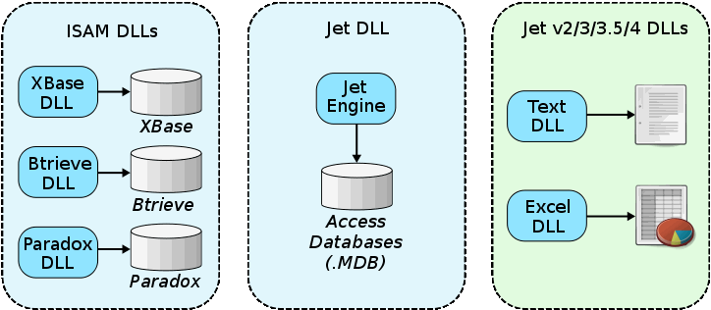
SPECIFICATIONS OF MC ACCESS
REPRESENTATION
Microsoft Access may be used as the 'front-end' of a program while other programs act as the 'back-end' tables.
Access tables support a variety of standard field types, indices, and referential integrity including cascading updates and deletes. Access also includes a query interface, forms to display and enter data, and reports for printing which is only achievable by Microsoft's unique Jet database.

Slide 6
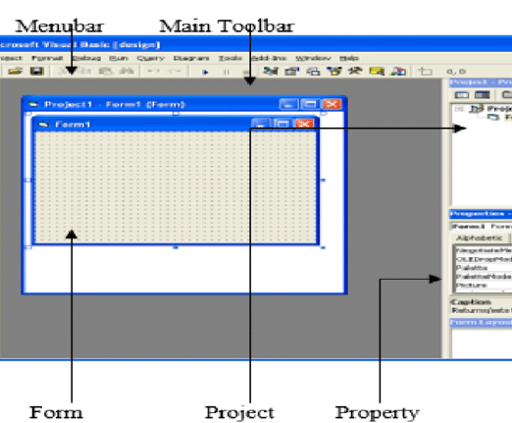
VISUAL BASIC 6.0/ CONCURRENT USERS
Programmers can create solutions using VBA, which is similar to Visual Basic 6.0 (VB6) and used throughout the Microsoft Office programs such as Excel, Word, Outlook and PowerPoint. Most VB6 code, including the use of Windows API calls, can be used in VBA.
The number of simultaneous users that can be supported depends on the amount of data, the tasks being performed, level of use, and application design. Generally accepted limits are solutions with 1 GB or less of data (Access supports up to 2 GB) and it performs quite well with 100 or fewer simultaneous connections

Slide 7

EVENTHOUGH WE ARE EMPHASIZING THAT "ACCESS" IS THE BEST DBMS, WHAT MAKES IT BETTER THAN OTHERS?

Slide 8


IT IS LIKE THE JOHN WICK OF THE OTHER DBMS , THAT IS BECAUSE IT IS DEVELOPED BY MICROSFOT.

Slide 9
FEATURES OF ACCESS
Advanced users can use VBA to write rich solutions with advanced data manipulation and user control. Access also has report creation features that can work with any data source that Access can access.
Import and export of data to many formats including Excel, Outlook, ASCII, dBase, Paradox, FoxPro, SQL Server and Oracle.
It can perform heterogeneous joins between data sets stored across different platforms.
Microsoft Access offers parameterized queries. These queries and Access tables can be referenced from other programs like VB6 and .NET through DAO or ADO.

Slide 10
IS IT BENEFICIAL TO UPGRADE TO THE FULL VERSION OF MS ACCESS OR NOT?

Slide 11
DIFFERENCE BETWEEN RUNTIME AND FULL VERSION.
RUNTIME VERSION
FULL VERSION
Available without any cost.
Access developers to create databases that can be freely distributed to an unlimited number of end-users.
The runtime version allows users to view, edit and delete data, along with running queries, forms, reports, macros and VBA module code.
Added features with additional purchase.
The full version allows users to change the design of Microsoft Access tables, queries, forms, reports, macros or module code.
Due to deprecated features in Access 2013, its runtime version is also unable to support older features.

Slide 12

WHY MS ACCESS?
Access has all the basic features necessary and is relatively easier to use than other databases.
The one thing that makes Access attractive to individuals and small businesses is that a relatively non-technical person can whip up a database in no time using Access.
Such individuals can create an Access database themselves without any outside assistance. They can keep track of projects, inventory, book keeping etc.

Slide 13

It is the Omega of Databases

Slide 14
MC ACCESS AND ITS CONTEMPORARY COMPONENTS.

Slide 15
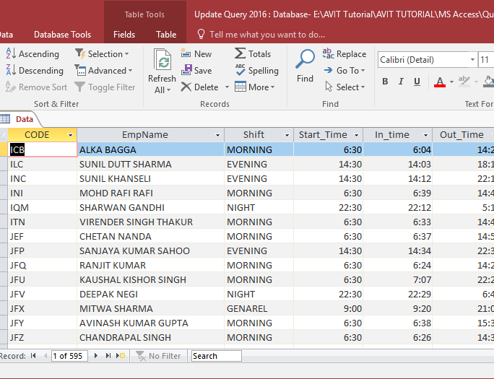
TABLES/QUERY
The accompanying image provides us with a basic overview of how a table/query looks and operates in Microsoft Access 2016.

Slide 16
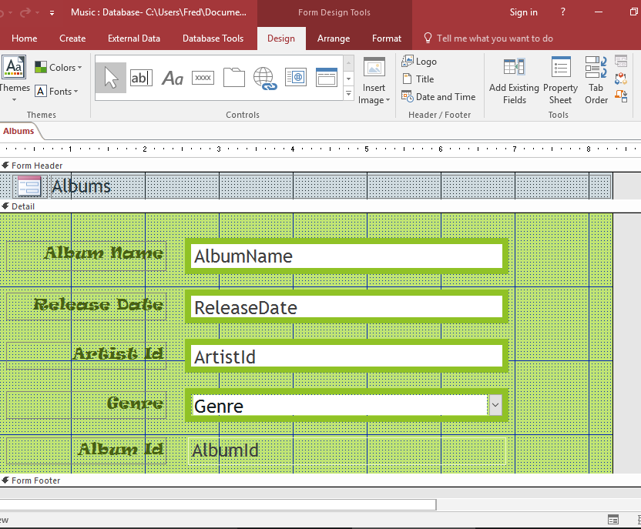
FORMS
One of the trademark features is the development of forms which can be easily created on MC Access. A representation of forms is as follows:-

Slide 17
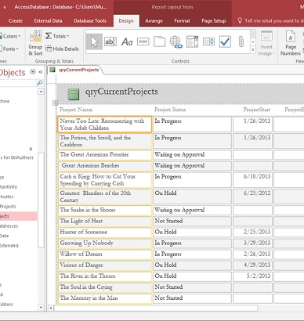

REPORTS
Reports are an essential part in any business or workplace and they can easily be made using MC Access. The image shall provide us with a basic overview of a report in Access.

Slide 18
MICROSOFT ACCESS
DEMOSTRATION

Slide 19
MICROSOFT ACCESS
Any Questions?

Slide 20
THANK YOU
Ibad Ahmed Shaikh
Haider Ali Baig
Saman Khan

